Slide 1
On The Future of Information Society: Emerging Trends, Security Threats and Opportunities
Marco Casassa Mont
(marco.casassa-mont@hp.com)
Senior Researcher
Systems Security Lab, HP Labs, Bristol
IEEE i-Society 2010
30 June 2010

Slide 2
Outline
Emerging Trends Affecting the Information Society
- Opportunities and Security & Privacy Threats
Organised Cybercrime and its Ecosystem
Needs and Requirements
R&D Work done in this Area by HP Labs
Conclusions

Slide 3
Outline
Emerging Trends Affecting the Information Society
- Opportunities and Security & Privacy Threats
Organised Cybercrime and its Ecosystem
Needs and Requirements
R&D Work done in this Area by HP Labs
Conclusions

Slide 4
Complex Information Society
Multiple Stakeholders: People, Enterprises,
Governments, Cybercriminals, …
New Services, Technologies and
ways to Communicate, Store and
Process Data & Information
Multiparty Interactions
and flow of Information spanning
across Personal, Organisational
and Legislative Boundaries
New Threats affecting People and
Organisations …
Organisation
Government
Agency
Organisation
Organisation
Security &
Privacy
Threats

Slide 5
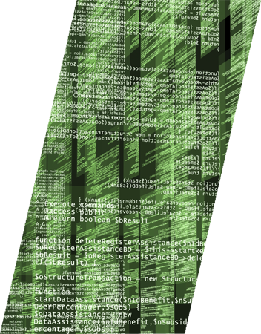
Emerging Trends Impacting the i-Society
Emerging Trends introducing new Exciting Opportunities
as well as Security and Privacy threats:
Mobile Computing and Pervasive Access to Web
Services
2. Increasing Adoption of Services in the Cloud
3. Multiple Personae and Digital Identities
4. (IT) Consumerisation of the Enterprise
Increasing Adoption of Social Networking for Personal and Business Purposes

Slide 6
Mobile Computing and Pervasive Access to Web Services

Slide 7
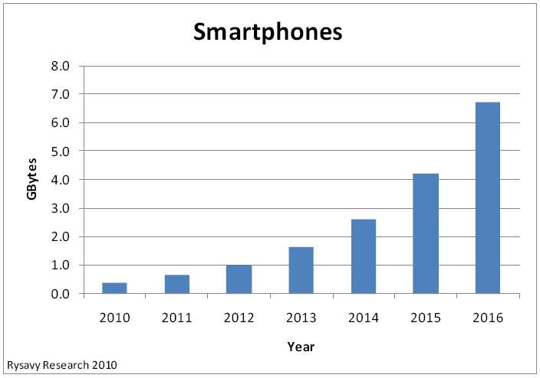
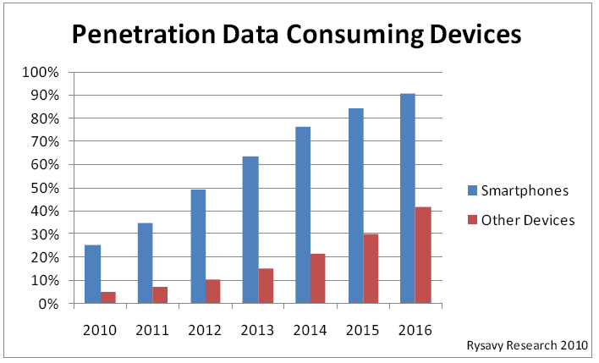
Growing Adoption of Smartphones
Adoption of Smartphones is Fast Growing:
+24% Sales Increase in 2009
(Gartner Source)
Yankee Group Predictions for 2013 (US):
- Estimated number of smartphone users : 160 million
- Estimated number of smartphone app downloads : 7 billion
- Estimated revenue from smartphone app downloads : $4.2 billion
Prediction of Major Growth of Data Traffic
(Rysavy Research)
Monthly Smartphone Data Consumption per Subscriber

Slide 8
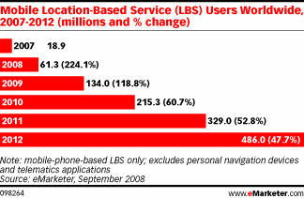
Growth of Usage of Mobile Applications
Major Growth of Applications Downloaded by Mobile Devices/Smartphones
Yankee Group Predictions for 2013 (US):
- Estimated number of smartphone app downloads : 7 billion
- Estimated revenue from smartphone app downloads : $4.2 billion
Increased Relevance of Location Based Services (LBS)
and LBS Users Worldwide
- 486M LBS Users by 2012
(Source: eMarketer)

Slide 9
New Opportunities and Threats
Opportunities:
  Connected anytime, anywhere
  Access services and information based on needs and location
  Carry out personal and work activities wherever you are
Threats:
  New security attacks to mobile devices: data leakage
  Privacy risks
  Profiling
  Personal data (PII) disclosed everywhere and shared between
  app providers
  Tracking people …

Slide 10
Adoption of Services in the Cloud

Slide 11
Services in the Cloud [1/2]
Growing adoption of IT Cloud Services by People and Companies,
in particular SMEs (cost saving, etc.)
Includes:
  Datacentre consolidation and IT Outsourcing
  Private Cloud/Cloud Services
  Public Cloud Services
  - Amazon, Google, Salesforce, …
Gartner predictions about Value of
Cloud Computing Services:
  2008 : $46.41 billion
  2009 : $56.30 billion
  2013 : $150.1 billion (projected)
Org
Org
Org
Cloud
Computing
Services

Slide 12
Services in the Cloud [2/2]
Some statistics about SME’s usage of Cloud Services
(Source: SpiceWorks):
Cloud initiatives from Governments
→ see UK g-Cloud Initiative
Org
Org
Org
Data Backup : 16% Email : 21.2% Application : 11.1% VOIP : 8.5% Security : 8.5% | CRM : 6.2% Web Hosting : 25.4% eCommerce : 6.4% Logistics : 3.6% Do not use : 44.1%
Cloud
Computing
Services

Slide 13
Personal Cloud Services
User-driven, Personal Cloud Services:
  - Multiple Interconnected Devices
  - Multiple Online Services
  - Multiple Data Sources and Stores
Forrester’s Prediction (by Frank Gillet):
  - Growing role of Personal Cloud Services and
  Decreasing Relevance of traditional Operating Systems …

Slide 14
Opportunities and Threats
Opportunities:
  Cost cutting
  Further enabler of IT Outsourcing (medium-large organisations)
  Better & cheaper services
  No lock-in situation with a service provider
  …
Threats:
  Potential lack of control on Data and Processes
  Proliferation of data and PII information
  Reliability and Survivability Issues
  Data protection and Privacy
  Reliance on third party …

Slide 15
Multiple Personae and
Digital Identities

Slide 16
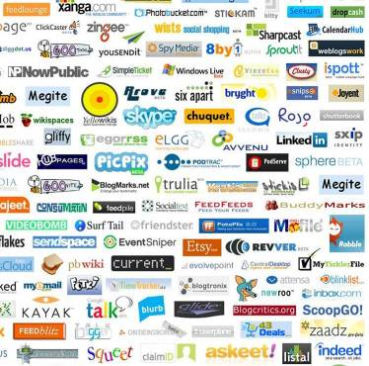
Multiple Personae and Digital Identities
Increasing number of Web Sites and Applications
accessed by People
Proliferation of User Accounts and Passwords
Microsoft Research Report - 2007 (Florencio and
Herley):
  Number of online accounts that an average user has: 25
  Number of passwords that an average user has: 6.5
  % of US consumers that use 1-2 password across all sites: 66%

Slide 17
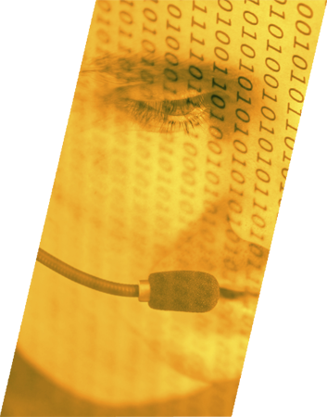
Federated Identity Management Hype
Lot of Promises and Hype about Federated Identity Management:
- It is happening in organisations (cost cutting)
- Not really for “valuable” Personal Web Apps/Solutions
Consequences:
  Proliferation of digital identities/personae
  Disclosure of data to multiple sites
  Mixing up of personal and work-related identities
  Waste of time in dealing with password recovery …

Slide 18
Threats
Privacy issue due to dissemination of personal data across multiple sites
and lack of Controls
Reuse of Passwords across Multiple Site (work, personal)
Lack of Security due to usage of Low Strength Passwords
Identity thefts …

Slide 19
(IT) Consumerisation of the Enterprise

Slide 20
Traditional (IT) Enterprise Model
Key role of CIOs/CISOs, Legal Departments, etc. in defining Policies and Guidelines
Controlled and Centralised IT Provisioning
IT Infrastructures, Services and Devices Managed by the Organisation
Enterprise
Corporate IT (security) Policies,
Provisioning & Management
Storage
Corporate
Devices
Servers
IT Services

Slide 21

Towards Consumerization of (IT) Enterprise
New Driving Forces:
  IT Outsourcing
  Employees using their own Devices at work
  Adoption of Cloud Services by Employees and the Organization
  Blurring Boundaries between Work and Personal Life
  Local Decision Making …
Cloud
Services
Services
Storage
Enterprise
IT Services
Storage
Personal
Devices
Servers
Servers

Slide 22
Opportunities and Threats
Opportunities for Employees and Organisations:
  Empowering users
  Seamless experience between work and private life
  Cost cutting
  Better service offering
  Transformation of CIO/CISO roles …
Threats:
  Enterprise data stored all over the places: Potential Data losses …
  Lack of control by organisation on users’ devices: potential security threats
  …

Slide 23
Adoption of Social Networking for Personal and Business Purposes

Slide 24
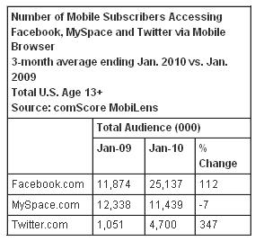
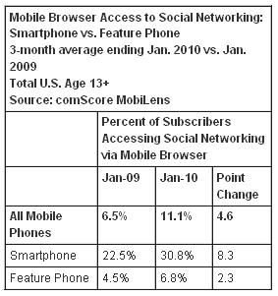

Social Networking by People and Organisations
Growth of adoption of Social Networking by both People (for private and work
matters) and Organisations
Mobile Social Networking
Sources: ReadWriteWeb.com and MobiLens

Slide 25
Social Networking: Opportunities and Threats
Changing Habits in Social Communication, Sharing of Information, Marketing …
Opportunity: almost unlimited Sources of Information and Opportunity to
Collaborate and Share data
Threats:
  Lack of control of data
  Data loss for organisations
  People profiling
  Privacy issues
  Long terms consequences and implications about published data, …

Slide 26
Outline
Emerging Trends Affecting the Information Society
- Opportunities and Security & Privacy Threats
Organised Cybercrime and its Ecosystem
Needs and Requirements
R&D Work done in this Area by HP Labs
Conclusions

Slide 27
Cybercrime: Leveraging the New Trends
Mobile Computing
Services in the Cloud
Multiple Personae and Digital Identities
Consumerisation of the Enterprise
Adoption of Social Networking
Organisations
Cybercriminals
People

Slide 28
Emerging Cybercrime Eco-System
Created by Forums
  Analogy to pubs/bars where criminals would meet in the physical world
  Co-operative crime environment
  “During his "work", a carder may specialize in one or several fields of carding. But there are no universal carders. Sooner or later, this carder will need services of another person. That's why there are some networks and rounds, people exchange numbers, information” – Script (a well known carder)
Simplifies Crime
  Advice
  Services
  Equipment
  Sale of stolen goods
Section Source & Credits: Adrian Baldwin & Benedict Addis, HP Labs, Bristol

Slide 29
E-Crime: Incentives and Deterrents
Opportunity
Payoff
+
Uncertainty
Forums/
Communities
Social Gain
Access to Remote
Victims
-
+
Benefits
+
Reputation
Costs
Rewards
+
Detection
+
+
Cost of Crime
Anonymity
+
+
Cost of Punishment
+
Jurisdiction
Equipment
Loss of Earnings
+
+
+
Services
Loss of
Employment
Fine
Loss of
future earnings
Forums/
Communities
Location of
Jobs
Skills

Slide 30
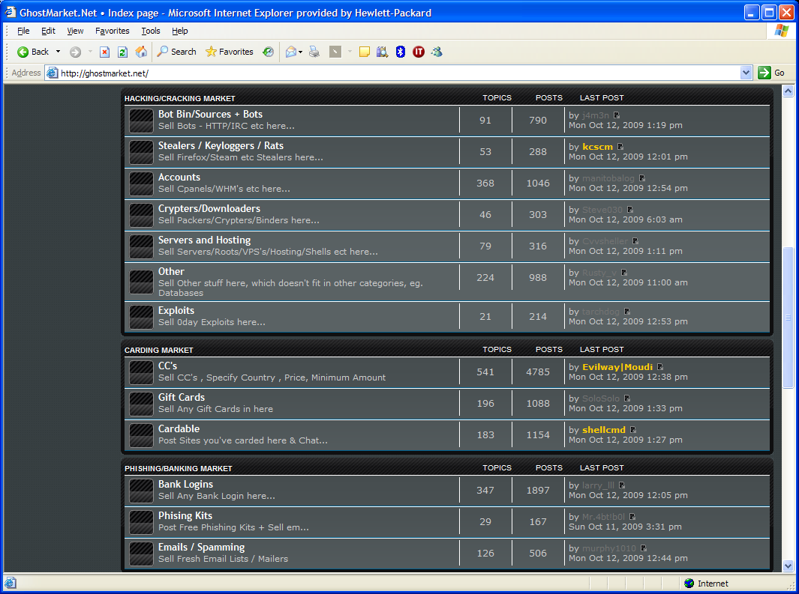
Multiple Services/Market places

Slide 31
Forum Population Dynamics
How long new users stay:
Transitory population
Many possible new trade partners
Who is trading:
Number of posts made by those
reporting issues on the blacklist.
Forum | Members | Have posted | Above basic status
Carders | 6697 | 1660 | 194
Hackers | 9712 | 3436 | 311

Slide 32
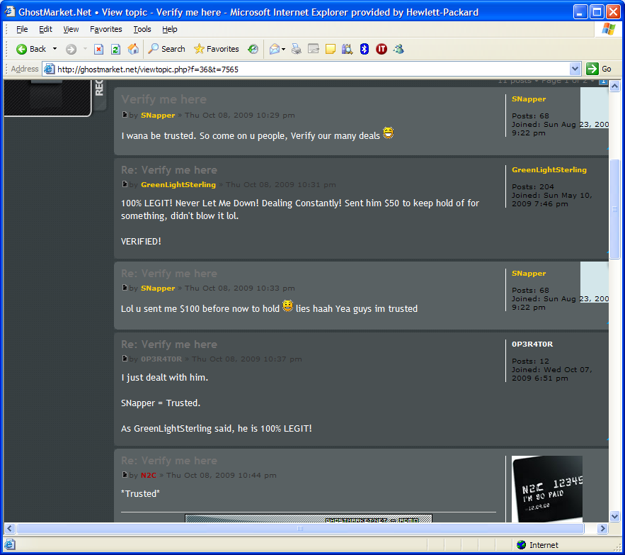
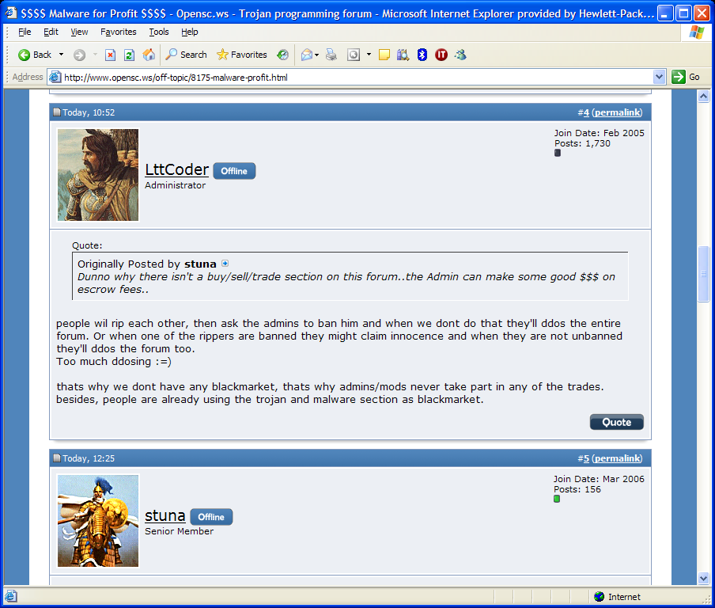
Reputation is Key

Slide 33
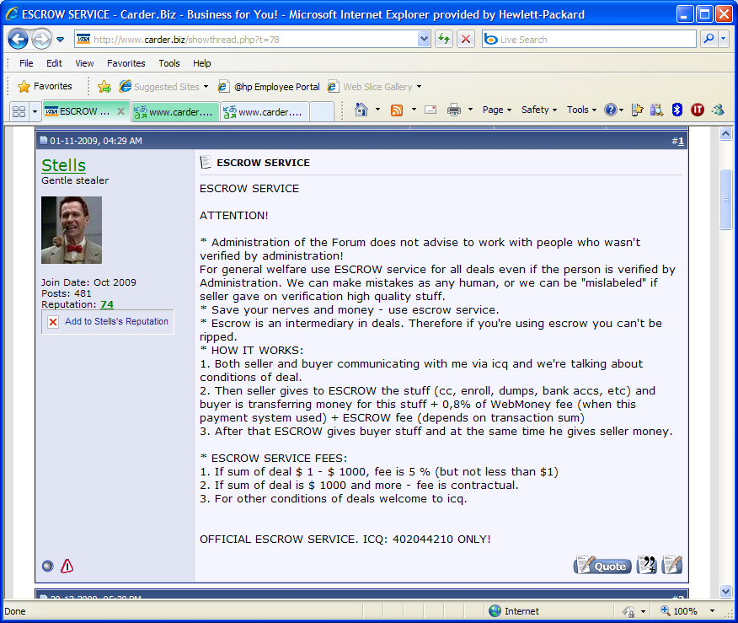
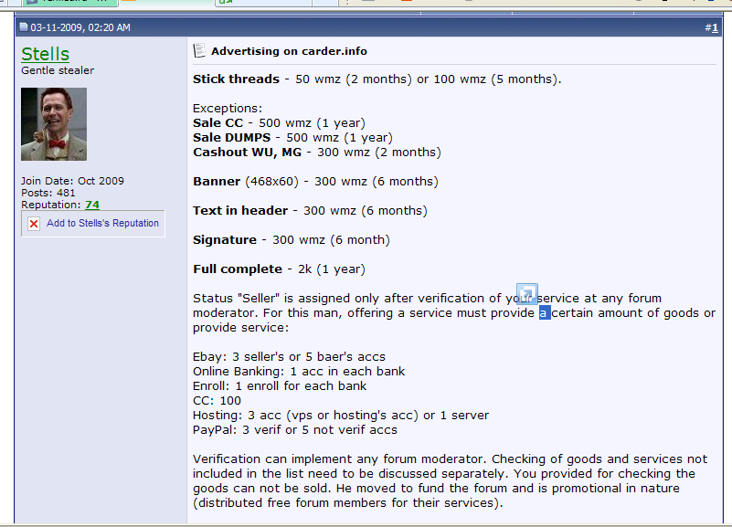
Escrow and Validation
Notes:
Points here is the admins act to smooth trade they provide a variety of services all at a cost such as advertising, verification and escrow these all act as trust building mechanisms

Slide 34
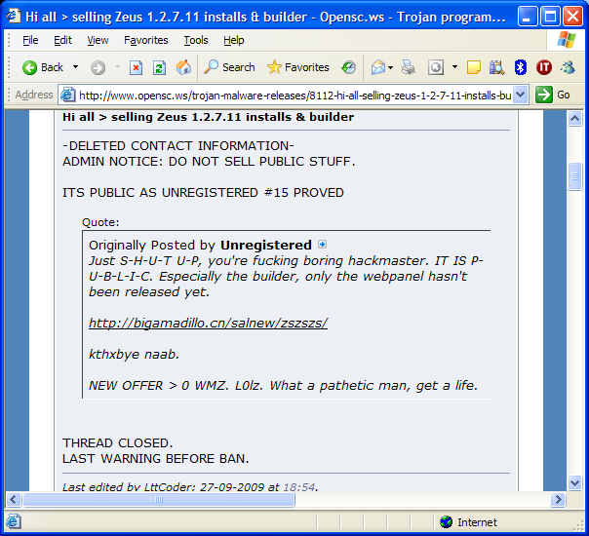
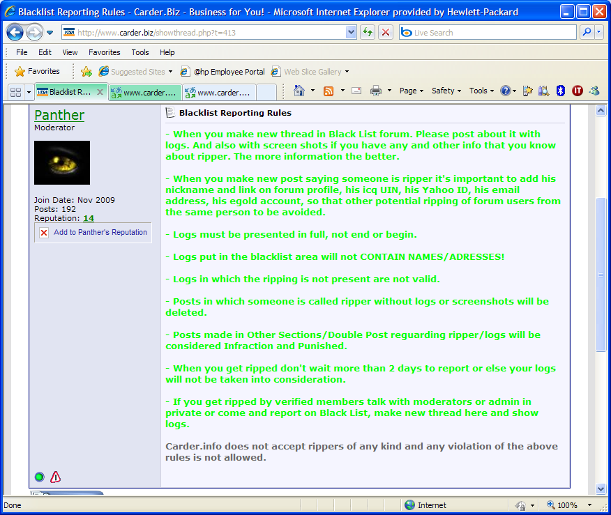
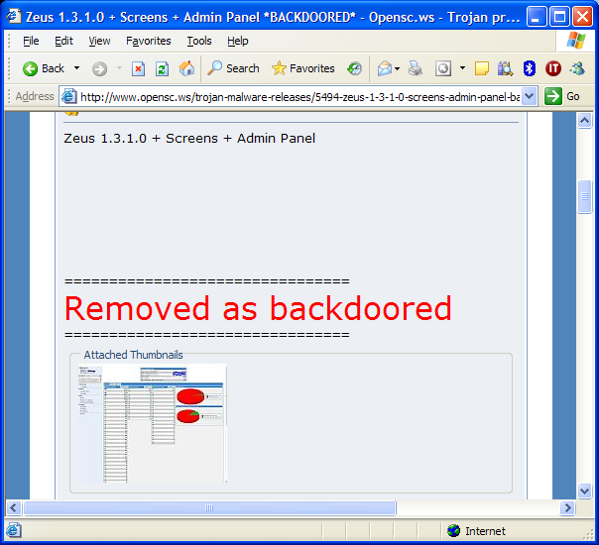
Admins act as Arbitrators
Hacking Forum
Carding Forum

Slide 35
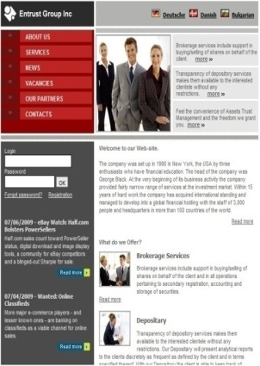


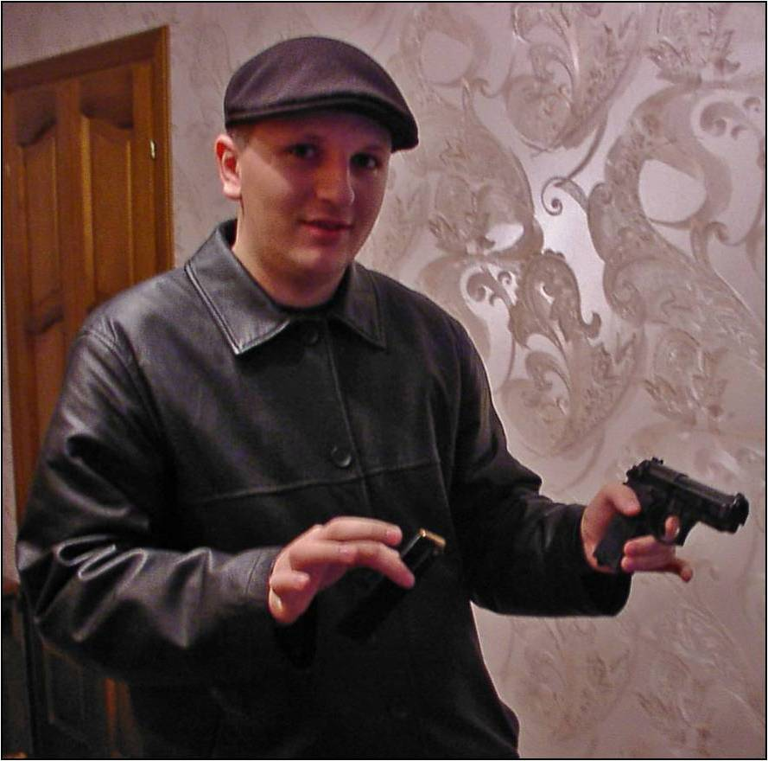
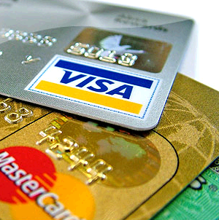
Basic Model of Underground Market
Mule
Recruitment
Extract
Mules /
Cashers
Scam
Payback
Marketplace
Sell
Sellers
(eg hackers,
phishers)
Buy
Buyers (eg carders)
35
30 June, 2010

Slide 36
Need to Understand Cybercrime and Motivations
Need to have a Creative Approach to Information Security
Need to Better Understand the Attackers in Order to:
  Identify likely targets
  Enable proactive defence (‘don’t wait to be attacked’)
  Prioritise the allocation of resources
  Think about future attacks/crimes
  Think about new ways to disrupt crime
  Effect change in public policy
Information Security tries to make crime harder
But whenever a defence is put in place, the bad guys find ways around it.

Slide 37
Actions to Disrupt
Disrupt
Recruitment
Block
credential use
Mules /
Cashers
Mule
Recruitment
Extract
Scam
Disrupt
payment
Payback
Marketplace
Sell
Sellers (eg hackers,
phishers)
Buy
Buyers (eg carders)
But, what are the actual impacts and Consequences of
these Disruption? …
Notes:
This is about financial accounts
Moving to enterprise accounts/SME accounts
What happens to Information sales?

Slide 38
Outline
Emerging Trends Affecting the Information Society
- Opportunities and Security & Privacy Threats
Organised Cybercrime and its Ecosystem
Needs and Requirements
R&D Work done in this Area by HP Labs
Conclusions

Slide 39
Needs and Requirements
People:
  Assurance about (Cloud) Services’ Practices
  Privacy and more Control on PII Data
  Transparency
Organisations:
  Assurance about (Cloud) Services’ Practices
  More Control and Trust on their IT Infrastructure, Devices and Data
  Better understanding of the Impact of Choices and Changes in terms of
  Costs, Security Risks, Productivity …

Slide 40
Outline
Emerging Trends Affecting the Information Society
- Opportunities and Security & Privacy Threats
Organised Cybercrime and its Ecosystem
Needs and Requirements
R&D Work done in this Area by HP Labs
Conclusions

Slide 41

HP Labs
Global talent, local innovation
BRISTOL
ST. PETERSBURG
PALO ALTO
BEIJING
BANGALORE
SINGAPORE
HAIFA
Notes:
HP Labs has 7 worldwide locations with hundreds of researchers.
The greatest concentration is in Palo Alto, our headquarters. We also have labs in Bristol, England; St. Petersburg, Russia; Beijing, China; Bangalore, India; Singapore; and Haifa, Israel.
Among our researchers are hundreds of PhDs. We have holders, collectively, of thousands of patents. And we have recognized global leaders in areas ranging from nanotechnology and computer algorithms, to data management and data mining, to digital signal processing and data compression.
Our 4 HP Senior Fellows and 7 HP Fellows – the highest distinction we have for our scientists – are as accomplished as any group of researchers in any corporate lab in the world. 10 of our researchers are fellows of IEEE, five are Fellows of ACM, and two are members of the National Academy of Engineering. They consistently win prestigious international prizes such as the Turing Award (the most prestigious short of the Nobel Prize in computing), the Hamming Award and the Feynmann Award.
Today, this group of brilliant minds is focused on fewer, bigger bets: 21 large-scale projects that fall under 8 high-impact research areas.
And we’ve put an emphasis on breakthrough research: 26% exploratory research and 71% applied research, up from 6% and 49% in FY07.
To ensure these bets pay off, we’ve established internal review boards to help guide the process of converting discoveries into commercial offerings.
In addition, while we have some of the best minds in the world at HP Labs, we know that we don’t have a monopoly on innovative ideas. So we’ve taken an open innovation approach and are actively partnering with leading companies, academic institutions, and government agencies.
Now I’d like to take a closer look at the 8 high-impact research areas we’ve identified.

Slide 42
HP Labs Research Portfolio
The next technology challenges and opportunities
Digital Commercial Print
Intelligent Infrastructure
Content Transformation
Sustainability
Cloud
Immersive Interaction
Analytics
Information Management
Notes:
We see these 8 areas as being the most important to the future of technology and the future of HP…and
We believe we have a significant opportunity to drive meaningful, even revolutionary progress.
We are continually evolving our efforts. As of today, we have organized our research into eight discrete, yet often interconnected themes:
Digital Commercial Print
Content Transformation
Immersive Interaction
Information Management
Analytics
Cloud
Intelligent Infrastructure
and Sustainability
Across these 8 themes, we have 21 big bet projects.

Slide 43
HIGH-IMPACT RESEARCH: FY09 HIGHLIGHTS
Business impact
26 high-impact technology transfers
Advancing the state-of-the-art
732 publications; 411 patents
Thought leadership
646 conference and workshop presentations, over 100 external awards
Engaging customers and partners
227 customer visits; top-tier customer engagements
Notes:
Here are the results from FY09….
Business impact
26 high-impact technology transfers
Advancing the state-of-the-art
732 publications, 411 patents
Thought leadership
646 conference and workshop presentations, over 100 external awards
Engaging customers and partners
227 customer visits

Slide 44

HP Labs: Systems Security Lab (SSL)
HP Labs Centre of Competence for R&D in Security
Based in Bristol, UK and Princeton, US
R&D work shaping the Future of i-Society …

Slide 45
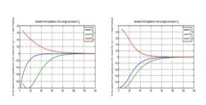
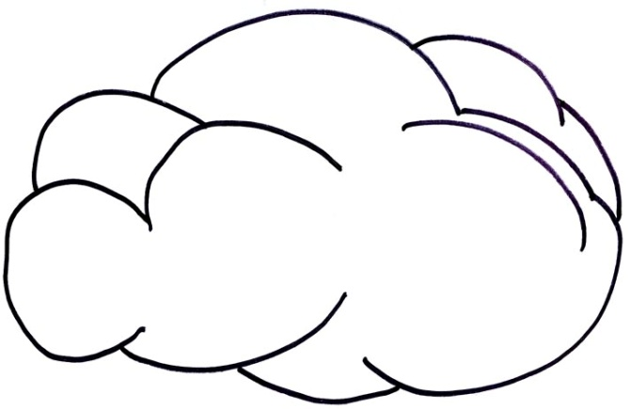
Today’s Security Management Lifecycle
Economics/
Threats/
Investments
Policy, process, people, technology
& operations
Governance and Risk -> Develop Policy - > Technology and Operations -> Infrastructure -> Risk, Assurance and Compliance ->
Malware
Exploit
Available
Vulnerability
Disclosed
Patch
Available
Malware
Reports?
N
Exposed?
Vulnerability
Assessment
Y
N
Y
Test
Solution
Patch
Available?
Accelerate?
Early
Mitigation?
N
Y
Y
Y
Patch
Deployment
Workaround
Available?
Deploy
Mitigation
Accelerated
Patching
Y
Implement
Workaround
Emergency
Patching
Security
Analytics
Personal
Environment
Win/Lx/OSX
Home
Banking
E-Govt
Intf.
Remote
IT Mgmt
Corporate
Productivity
OS
Corporate
Production
Environment
OS
Corp.
Soft
Phone
Assurance &
Situational Awareness
Trusted Hypervisor
Trusted Infrastructure

Slide 46

Some Relevant R&D Work at SSL
Trusted Infrastructure
Security Analytics
Privacy Management

Slide 47
Trusted Infrastructure

Slide 48
Trusted Infrastructure
Ensuring that the Infrastructural
IT building blocks of the Enterprise
and the Cloud are
secure, trustworthy
and compliant with
security best practice
Trusted
Computing
Group (TCG)
/
Impact of
Virtualization
Trusted
Client
Infrastructure
Cloud
Provider #1
On Demand
CPUs
Printing
Service
CRM
Service
Office
Apps
Data
Storage
Service
User
Trusted
Client
Devices
…
Cloud
Provider #2
Enterprise
Backup
Service
Trusted
Client
Infrastructure
Trusted
Client
Infrastructure
ILM
Service
Service
Employee
Service
Service 3
Service
Business
Apps/Service
…
…
Internal Cloud
…
The
Internet
TCG: http://www.trustedcomputinggroup.org

Slide 49

Trusted Infrastructure
Evolution Towards Services in The Cloud
More and more applications and services will be delivered on remote infrastructures we don’t own
However, we need to maintain the user experience whether or not there is good network connectivity
A new business need is emerging that will benefit from a mix of thin and thick client capabilities
Hence we need:
  a new generation of client devices that provide safe and adaptive access to cloud services…
  …and more than ever we need to be able to manage them at reduced cost
  A new generation of servers that are trusted and whose security capabilities can be tested and proved
Hypervisor
OS
TVA
TVA
Hosted HALO application
TVA
Open Network - Cloud -
Hypervisor
Hosted VOIP application
OS
TVA
TVA
TVA
Hosted TVC Management
Hypervisor
OS
TVA
Hosted CCI infrastructure
TVA
TVA
Hypervisor
OS
TVA
TVA
TVA
Untrusted Open Internet
Source: HP Labs, Systems Security Lab, Richard Brown
Secure Distributed Business Application
Notes:
We need to emphasize how the infrastructure environment is changes (the biz/personal story is great but getting old and is being copied by others).
Whether we talk about Cloud, utility computing, distributed computing… we can be certain that infrastructures are changing to a more service oriented model but not a lot of effort is being invested in understanding how this affects the user client device. Enterprises now want to reduce IT cost per seat and hence will want to move away from the tradition thick client model to a more thin client with the computing in the backend systems (not owned by themselves). This is fine when network connectivity is good, however, due to the increase in mobility the user experience is likely to be massively affected. So we need ways in which some of the remote service can be securely deployed locally on the device when there is little or no networking and then be able to synchronize when connectivity returns. Hence, the thin only client model will also be inadequate in this environment.
We need a new generation of device that can support a range of thick and thin clients that provide both enhanced user experience and at the same time meets the enterprise’s demands for reduced IT costs. IT Management entities want to drive towards zero support calls, and generally self service deployment of business machines. “Engineer to zero”
We need the Trusted Virtualized Client

Slide 50
Trusted Infrastructure: Trusted Virtualized Platform
HP Labs: Applying Trusted Computing to Virtualization
Personal
Client Persona
Secure Corporate (Government)
Client Persona
Services managed from cloud
Personal
Environment
Win/Lx/OSX
Home
Banking
E-Govt
Intf.
Remote
IT Mgmt
Corporate
Productivity
OS
Corporate
Production
Environment
OS
Corp.
Soft
Phone
Trusted Hypervisor
Trusted Personal
Client Appliances
online (banking, egovt) or local (ipod)
Trusted Corporate
Client Appliance

Slide 51
Paradigm Shift: Identities/Personae as “Virtualised Environment” in the Cloud
Trusted
Domain
My Persona 1 +
Virtualised
Environment 1
My Persona 2 +
Virtualised
Environment 2
Bank
…
Gaming
Community
Services
Trusted Hypervisor
End-User Device
Using Virtualization to push Control from the Cloud/Service back to the Client Platform
User’s Persona is defined by the Service Interaction Context
User’s Persona & Identity are “tight” to the Virtualised Environment
Persona defined by User or by Service Provider
Potential Mutual attestation of Platforms and Integrity

Slide 52
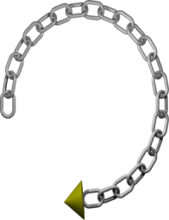



Specifiable, Manageable and Attestable Virtualization Layer
Leverage Trusted Computing technology for Increased Assurance
→ Enabling remote attestation of Invariant Security
Properties implemented in the Trusted Virtualization Layer
Management
Domain
Trusted Virtual Platform
Trusted Virtual Platform
Virtualised
TPM (vTPM)
Banking
Application
Gaming
Application
Software
Integrity
vTPM
vTPM
Trusted Infrastructure Interface (TII)
Physical
Platform
Identity
Firmware
TPM
Notes:
Earlier I said that we want to create a virtualization system that could be attested to, i.e. that we could make a strong statement as to the trustworthiness of it’s current state. So I want to spend a few moments expanding on this.
Explain what a chain of trust is. We want to build systems that are immune from s/w attacks. So we build a chain of trust which is anchored in h/w which gives us a resilience to s/w attacks. It starts with the TPM (crypto device) that is bound to the mother board and we guarantee that this device will be in a known state when initially powered on. Associated with this is a Core Root of Trust for Measurement (CRTM), which is the BIOS boot block code; it can’t itself be measured but it is a piece of code which is considered trustworthy. It reliably measures integrity value of other code, and stays unchanged during the lifetime of the platform. CRTM is an extension of normal BIOS, which will be run first to measure other parts of the BIOS block before passing control. The BIOS then measures hardware, and the bootloader and passes control to the bootloader. The bootloader measures VMM kernel and pass control to the VMM and so on. What you end up with is a chain of trust with a measurement value that can be used for attestation.
TPM stores measurements and can cryptographically report on those measurements to requesting parties (attestation). Essentially, the TPM signs the measurement (which is a cryptographic hash) so that the one asking for the measurement can know that it was measured by a real TPM. The requestor then checks this measurement against a known good value to determine whether or not this system can be trusted.
This is an important feature of these TCG TPMs but one that has yet not been fully exploited. What we are doing within our project is to create an Integrity Measurement and Attestation framework. Specifically designed for measuring the VMM and its supporting security services so that it can attest itself to other platforms that request verification. At its lowest level it will utilize TCG TPM hardware technology and associated CPU / Chipset support such as the Intel (TXT) / AMD (SVM) for DRTM (Dynamic Root of Trust) mechanisms [Grawrock 2006]. Our planned approach diverges from existing integrity measurement systems in regard to its explicit support for the needs of virtualized systems such as chains of trust that can be safely dynamically modified [Cabuk et al. 2008a] and the support for tying the integrity of several VMs together into a single attestable and verifiable entity.
TXT allows us, in combination with the TPM, to ensure that either a Measured Launch Environment or Controlled Launch Environments can be started. MLEs allow any code sequence to run, but generate a launch record which is difficult to forge by an alternative startup sequence. Controlled Launch allows us to refuse to start a particular code image unless the hardware has followed an already approved execution path. We have some functional code which demonstrates MLE, and the functionality to enforce CLE is being developed now.

Slide 53
Security Analytics

Slide 54

Security Analytics
Putting the Science
into Security
Management
Notes:
Most security strategy, policy and investments decisions are based on intuition and best practices.
Security Analytics is about using scientific methods to make security management rigorous and evidence based.
30 June 2010
HP Confidential
54

Slide 55
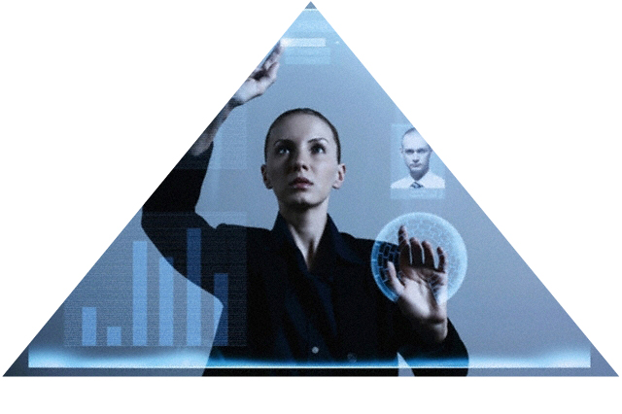
Complexity, Costs, Threats and Risks are All Increasing
Trying harder is not enough – we have to get smarter
Notes:
We believe this is more necessary as information security gets harder.
With cloud computing, virtualization, consumerization, more business reliance on IT – and pressure on the IT budget - it gets harder to justify any expenditure, and yet with the burgeoning threat environment this must be done.
Yes, we can continue to try harder, but it feels like a change in approach is needed, one where we get smarter – hence security analytics.
30 June 2010
HP Confidential
55

Slide 56

Security Analytics:
Integrating Scientific Knowledge
Security/Systems
Domain knowledge
Economic Theory
(utility, trade offs,
externalities, information asymmetry, incentives)
Applied
Mathematics
(probability theory,
queuing theory,
process algebra,
model checking)
CISO / CIO /
Business
Empirical Studies
(Grounded theory,
discourse analysis,
cognitive science)
Experiment and Prediction
(Discrete event modelling
and simulation)
Business Knowledge
Notes:
Today most security teams have good knowledge about IT and are working hard to align this with business knowledge.
We are looking to take this further to make business aligned security decisions based on simulation and prediction. To support this we are using appropriate economic and mathematical tools
30 June 2010
HP Confidential
56

Slide 57
RESEARCH THROUGH COLLABORATION
Customer pilots
Sample of major studies with customers
  USB stick study with Merrill Lynch
  VTM study with large international bank
  IAM study with large UK government department
  Deperimeterization study with large international bank
Major drive towards repeatable engagements
  Current portfolio of IAM and VTM
  Continue to seek customer research partners for further studies

Slide 58
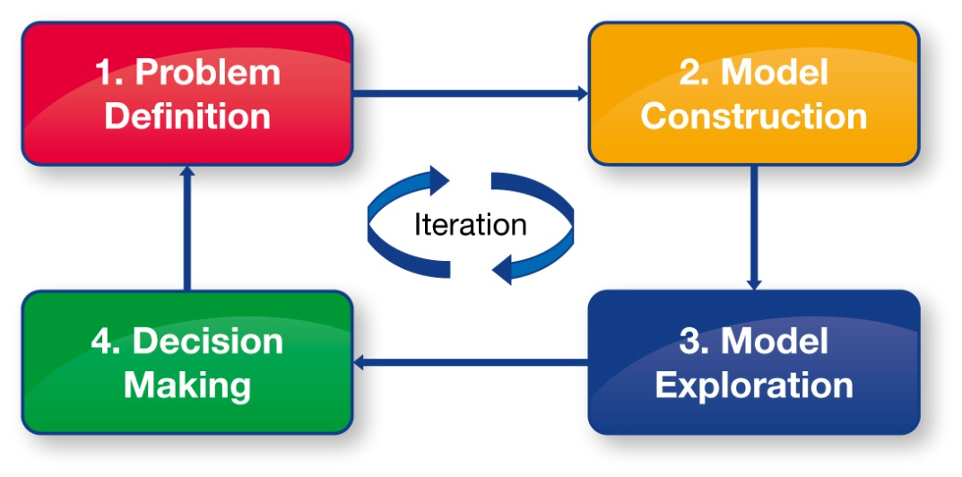
PACKAGED SECURITY ANALYTICS
Transforming security management to one based on scientific rigor
Launched at Infosec 2010 as part of Security Business Intelligence
Based on VTM/IAM case studies
Iterative engagement approach to define the problem and explore possible solutions and their tradeoffs
Generation of full report
Notes:
This is part of an ongoing ambitious research programme, and our first deliverable is to offer a packaged Security Analytics services engagement, together with the tools and methodology, for both Vulnerability and Threat Management, and also for Identity and Access Management.
Starting with an initial workshop to explore your unique security challenges and identify the strategic priorities, appropriate models will be created and explored to determine the possible outcomes of key security decisions which are available to you. At the end of the exercise you will receive a full report documenting the challenges addressed, the options explored and conclusions drawn.
30 June 2010
HP Confidential
58

Slide 59
Security Analytics
VTM Example

Slide 60
VULNERABILITY AND THREAT MANAGEMENT
Patch
Deployment
HIPS
Network
Security
Patch Testing
Multiple IT
Environments
Multiple
Business Processes
Vulnerability &
Threat Management
Anti-Virus
Patch
Acceleration
Temporary
Workarounds
Multiple
Regions
Emergency
Processes
Vulnerability
Assessment
Notes:
For example – with Vulnerability and Threat Management
There are a number of complex and inter-related processes and technologies,
Patching, signature based mechanisms, decisions to build workarounds, or to escalate issues. How do you determine which is effective, and if or where we should be doing more?
30 June 2010
HP Confidential
60

Slide 61
THE SOLUTION: BUILD A MODEL
Stochastic model of threat environment
Process model of organization’s protections
Validate with experts and against known data sources
Select a metric
  Time until “risk mitigated”
Execute the model as a discrete event simulation
  ~100K vulnerabilities
  check for sensitivities in parameters
Adjust the model to reflect proposed changes in policy and see how well the changes perform

Slide 62
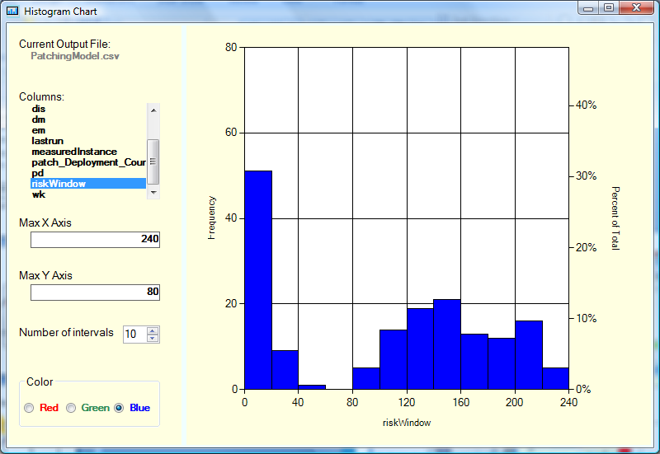
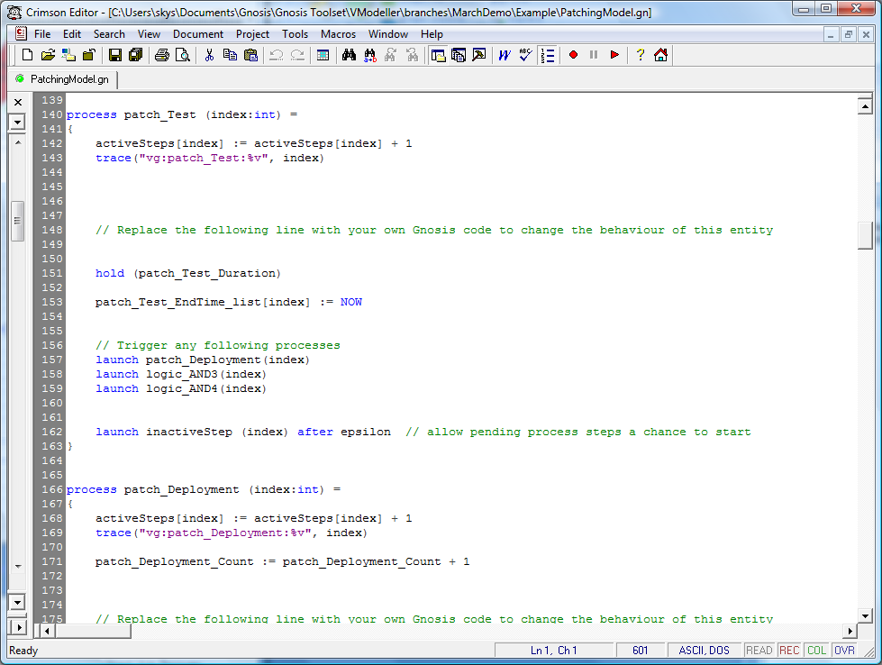
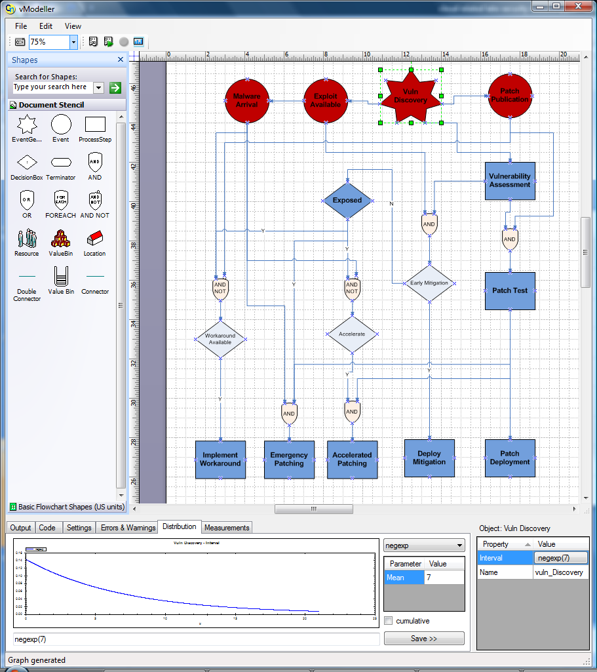
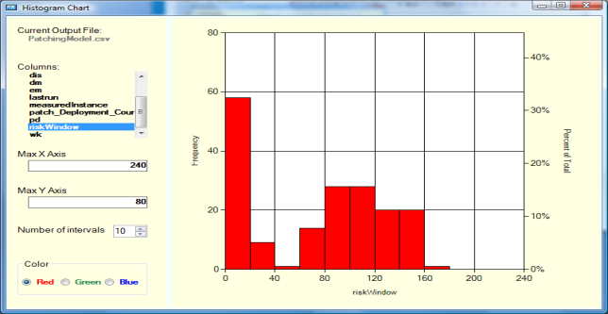
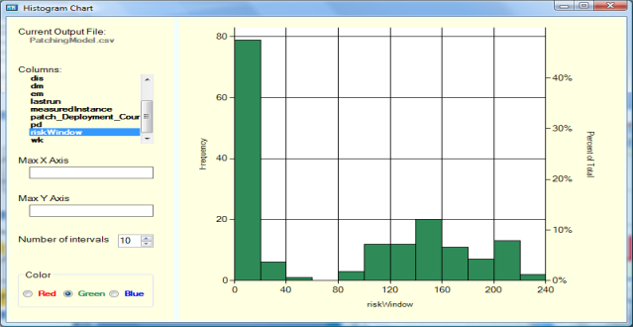
SECURITY ANALYTICS TOOLS
Current Risk Window
Generates simulation/
Experiment results
Risk Window with
Patch Investment
Generates code for the underlying Gnosis Engine
Risk Window with
HIPS investment
Notes:
Use this slide if running an actual demo proves to be too difficult logistically
30 June 2010
HP Confidential
62

Slide 63
Security Analytics
Cybercrime Example

Slide 64
Basic Model of Underground Market
Mule
Recruitment
Extract
Mules /
Cashers
Scam
Payback
Marketplace
Sell
Sellers
(eg hackers,
phishers)
Buy
Buyers (eg carders)
Source: Adrian Baldwin, Benedict Addis, HP Labs, Bristol
64
30 June, 2010

Slide 65
Actions to Disrupt
Disrupt
Recruitment
Block
credential use
Mules /
Cashers
Mule
Recruitment
Extract
Scam
Disrupt
payment
Payback
Marketplace
Sell
Sellers (eg hackers,
phishers)
Buy
Buyers (eg carders)
What is the actual Impact and Consequences of
these Potential Disruptions? …

Slide 66
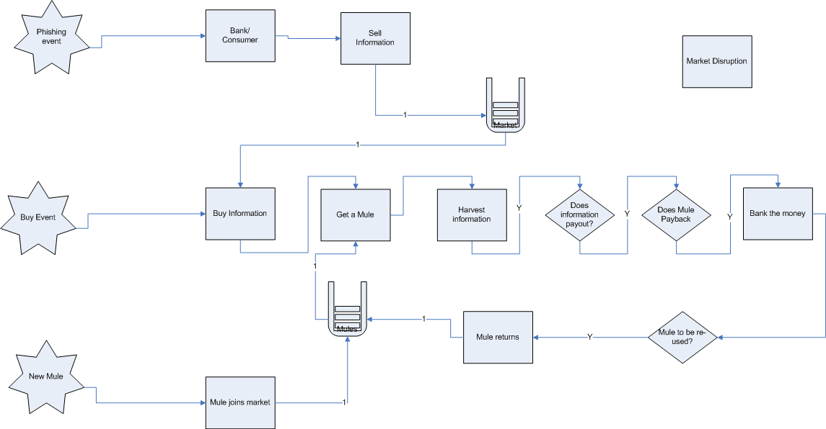
Underground market (more refined)
66
30 June, 2010

Slide 67
Buyer profit
In the baseline model + for 4 disruption strategies
67
30 June, 2010

Slide 68
Seller reputation
Represents the marketplace’s long-term trust in the sellers
68
30 June, 2010

Slide 69
Security Analytics
Identity and Access
Management (IAM) Example

Slide 70
IAM Investment Options
Focus on Decision Makers within Organisations
  Worried about threats
  Limited Budget
  Need to consider Trade-offs
IAM Investments Classified in terms of:
  Provisioning
  Compliance
  Enforcement
IAM Investments have different Impacts on Strategic Outcomes of Interest:
  Provisioning → Productivity and Security
  Compliance → Governance and Security
  Enforcement → Security

Slide 71
Classes of IAM Investments
Assumptions: 5 Classes of IAM Investment Levels, in the [1,5] Range, with an increasing Impact in term of Effectiveness of Involved Control Points, Policies and Costs:
Productivity
1
2
3
4
5
Compliance
1
2
3
4
5
Enforcement
1
2
3
4
5
Ad-hoc Processes
and Manual
Approaches
Hybrid Approaches
Degrees of Automation
and Policy Definition
Strong Automation
and Integration with
Security and
Business Policies
Reference: Economics of IAM – HPL TR - http://www.hpl.hp.com/techreports/2010/HPL-2010-12.html

Slide 72
Security Analytics - Methodology for Decision Support
1. Strategic Preferences are Elicited from Decision Makers by
using Targeted Questionnaires to Identify Priorities and Trade-offs
2. Executable Mathematical Models keep into account:
Strategic Preferences
Architectural
Policies
Business and IT Processes
Dynamic Threat Environments
3. Predictions of Models can be Validated against the Targets
and Preferences of Decision Makers

Slide 73
Elicitation of Strategic Preferences
Understanding Decision Maker’s bias e.g. towards Productivity

Slide 74
High-level IAM Model
User Joining
Event
User Changing
Role(s) Event
User Leaving
Event
Audit Event
Internal
Attack Event
External
Attack Event
Ex-Employee
Attack
User Joining
Provisioning
Process
User Changing
Role(s)
Provisioning
Process
User leaving
Provisioning
Process
Auditing
Process
Attack
Processes
Status
Access Status:
# BIZ Access
# NONBIZ Access
# BAD Access
# NON Access
# Other Access
(hanging accounts)
Apps Status:
Apps Status: #Weak,
#Medium, #Strong
Measures:
# Incidents
# Access & Security
Compliance Findings
# Access & Security
Remediation
# Access & Security
Audit Failures
% Productivity
Investment Options [Parameters]
Provisioning Level
Compliance Level
Enforcement Level
Compliance
Checking &
Remediation
Process
Application
Security
Weakening
Process
Application
Security
Strengthening
Process
Compliance
Check Event
App. Security
Weakening Event
App. Security
Strengthening
Event

Slide 75
Simulation: Outcomes for Productivity, Security Incidents and Audit Failures

Slide 76
Strategic Decision Support – Mapping Simulation Outcomes against Preferences
Elicited Preferences
Providing Predictions on how to Achieve Decision Maker’s High Priority Preferences

Slide 77
Privacy Management

Slide 78
Privacy Management
TSB EnCoRe Project
- EnCoRe: Ensuring Consent and Revocation
UK TSB Project – http://www.encore-project.info/
“EnCoRe is a multi-disciplinary research project, spanning across a number of IT and social science specialisms, that is researching how to improve the rigour and ease with which individuals can grant and, more importantly, revoke their consent to the use, storage and sharing of their personal data by others”
- Problem: Management of Personal Data (PII) and
Confidential Information driven by Consent & Revocation

Slide 79
EnCoRe:
Enabling the Flow of Identity Data + Consent/Revocation
On Demand
CPUs
Printing
Service
CRM
Service
Identity Data & Credentials
+
Consent/Revocation
Office
Apps
Identity Data & Credentials
+
Consent/Revocation
Data
Storage
Service
User
Delivery
Service
Cloud
Provider #1
Identity Data & Credentials
+
Consent/Revocation
Enterprise
Identity Data & Credentials
+
Consent/Revocation
Enterprise
Backup
Service
Cloud
Provider #2
ILM
Service
Service 3
…
…
The
Internet
…

Slide 80
EnCoRe:
Explicit Management of Consent and Revocation
Cloud
Provider #1
EnCoRe
ToolBox
On Demand
CPUs
EnCoRe
ToolBox
Printing
Service
CRM
Service
Office
Apps
Data
Storage
Service
User
EnCoRe
Toolbox
EnCoRe
ToolBox
…
Cloud
Provider #2
EnCoRe
ToolBox
Enterprise
Enterprise
Backup
Service
EnCoRe
ToolBox
ILM
Service
Service 3
…
…
The
Internet
…

Slide 81
EnCoRe Project
Various Case Study:
  Enterprise Data
  Biobank
  Assisted Living
Press Event: 29/06/2010
http://www.v3.co.uk/v3/news/2265665/hp-working-privacy-tool
http://finchannel.com/Main_News/B_Schools/66174_LSE%3A_Turning_off_the_tap_for_online_personal_data_-_prototype_system_unveiled_by_EnCoRe_/
Technical Architecture and Solutions available online:
http://www.encore-project.info/

Slide 82
Explicit Management of Consent and Revocation

Slide 83
Outline
Emerging Trends Affecting the Information Society
- Opportunities and Security & Privacy Threats
Organised Cybercrime and its Ecosystem
Needs and Requirements
R&D Work done in this Area by HP Labs
Conclusions

Slide 84
Conclusions
New Emerging Trends are affecting the future of the Information Society
Along with New Opportunities there are New Threats. Need to understand them
Need to Understand the Emerging Cybercrime and its Implications
Need to provide more Assurance and Trust to People and Organisations
HP Labs Systems Security Lab (SSL) is working to shape the future of the Information Society

Slide 85
Q&A
More Information:
Marco Casassa Mont, HP Labs, marco.casassa-mont@hp.com
http://www.hpl.hp.com/personal/Marco_Casassa_Mont/

